Slide 1

SUPPLY CHAIN ANALYTICS
MUSTAFA - THE DATA ANALYST

Slide 2


PROBLEM STATEMENT
Stakeholders were facing problem to understand their supply chain business.

Slide 3
TASK
The dashboard allowed them to track inventory levels, monitor delivery performance, and identify bottlenecks.

Slide 4
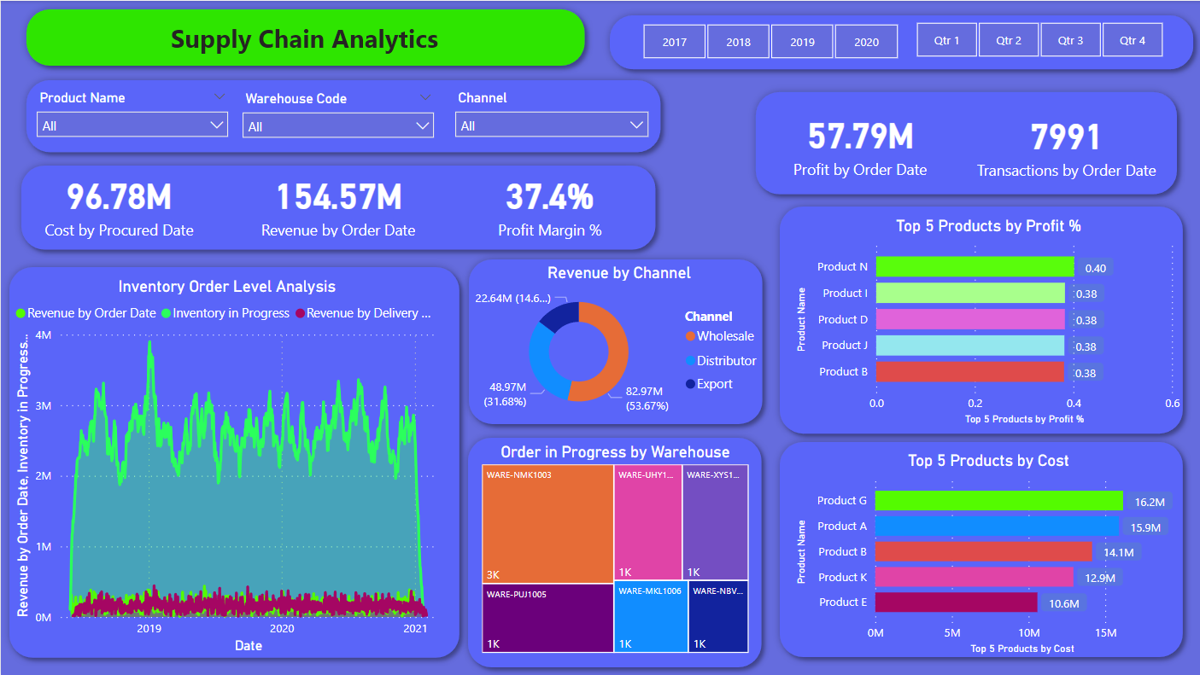
DASHBOARD

Slide 5
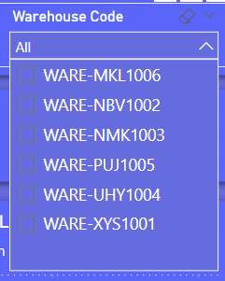
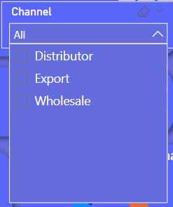
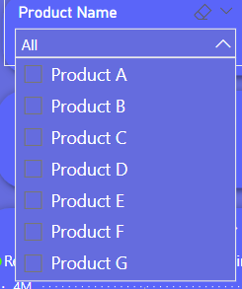
FILTER BY NAME/WAREHOUSE/CHANNEL

Slide 6

FILTER BY YEAR & QUARTER

Slide 7
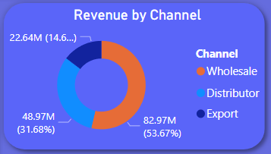
REVENUE BY CHANNEL

Slide 8
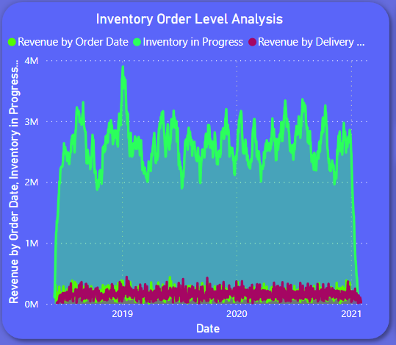
INVENTORY ORDER LEVEL ANALYSIS

Slide 9
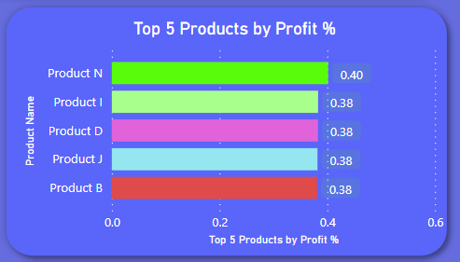
TOP 5 PRODUCTS BY PROFIT %

Slide 10
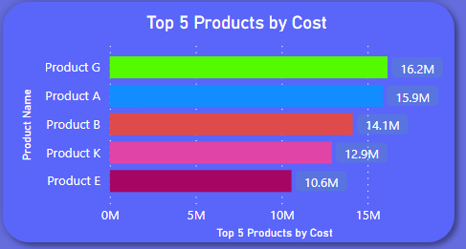
TOP 5 PRODUCTS BY COST

Slide 11
THANK YOU
Email: canabisradarforbusiness@gmail.com
Phone(Whatsapp):+923494624108
Linkedin: www.linkedin.com/in/mustafatheanalyst/

